Slide 1
COMP 2406
Mechanics of Procedure Stack
(In no particular language)

Slide 2
Review of how Procedure Call Stack and Heap Work
No particular language but typical of
Java, C, C++ (languages taught in 1st year)
Here we review what is probably your understanding of how function and procedure calls work (probably as was taught to you in first year programming courses.)
We also consider “objects” that are typically allocated on the heap, as opposed to procedure stack.
Our reason for doing this is to see if this model will still hold up for Javascript. In particular Javascript's notion of Closures

Slide 3
Stack and Heap
heap
memory
When a program runs the OS grants it some memory to work within.
The memory is used in two distinct regions: the stack and the heap.
A typical way to implement the stack and the heap is to use the contiguous allocated memory and grow the stack from one end and the heap from the other.
If the two ever collide an “out of memory” or “stack overflow” run-time error results.
Memory can overflow because of a bug, or because a program simply needs more memory than is available.
Some programing techniques, like recursion, can easily get out of hand and use up a lot of stack space to represent sub-problems.
stack
memory

Slide 4
Review of how Procedure Call Stack and Heap Work
heap
memory
The heap is used for items, most often created with new, that have a lifetime independent of the function call that created them.
Items on the heap remain there until they are explicitly deleted.
In non-garbage collected languages, like C++, C, heap items are removed by the programmer explicitly.
In garbage collected languages like Java, heap items are removed by a garbage collector when they are no longer accessible.
Garbage collectors are often viewed as slower but safer.
There is no specific order to where things are placed in the heap. (In fact a “heap manager” might run in the background and continuously re-arrange and defragment the heap.)
stack
memory

Slide 5
Review of how Procedure Call Stack and Heap Work
heap
memory
The stack is used to implement procedure, or function, calls.
When a procedure is called a “stack frame” representing that procedure is placed on top of the stack; when the procedure returns its stack frame is popped off the stack.
The stack grows and shrinks in a “first in –last out” sequence.
So the lifetime of stack frames matches exactly the calls and returns of the procedures they represent. (By contrast, the lifetime of items on the heap is independent of the function calls that placed them there.)
Since procedures can be called at any time and from anywhere, they cannot make assumptions about what is “below them” on the stack.
stack
memory

Slide 6
Review of how Procedure Call Stack and Heap Work
Example: Function calls with only parameter passing, return values and primitive local variables

Slide 7
Mechanics of Procedure Stack (no particular language)
heap
memory
int g(int i) {
int j = i*i;
return j;
}
int f(int x) {
int y = g(x + 2);
return x + y;
}
main(){
int z;
z = 10;
z = f(z+2);
print(z);
}
top
Main
z
main frame
stack
memory
Notes:
Discussion exercise: Why might using formal constants be better than using #define macro style constants? Does declaring an identifier as constant result in storage allocation? Generally not, the compiler is smart enough in most cases to simply substitute the constant value.

Slide 8
Mechanics of Procedure Stack (no particular language)
heap
memory
int g(int i) {
int j = i*i;
return j;
}
int f(int x) {
int y = g(x + 2);
return x + y;
}
main(){
int z;
z = 10;
z = f(z+2);
print(z);
}
top
Main
z: 10
main frame
stack
memory
Notes:
Discussion exercise: Why might using formal constants be better than using #define macro style constants? Does declaring an identifier as constant result in storage allocation? Generally not, the compiler is smart enough in most cases to simply substitute the constant value.

Slide 9
Mechanics of Procedure Stack (no particular language)
heap
memory
int g(int i) {
int j = i*i;
return j;
}
int f(int x) {
int y = g(x + 2);
return x + y;
}
main(){
int z;
z = 10;
z = f(z+2);
print(z);
}
top
f
x: 12
y
ret addr:..
ret val
f frame
top
Main
z: 10
main frame
stack
memory
Notes:
Discussion exercise: Why might using formal constants be better than using #define macro style constants? Does declaring an identifier as constant result in storage allocation? Generally not, the compiler is smart enough in most cases to simply substitute the constant value.

Slide 10
Mechanics of Procedure Stack (no particular language)
heap
memory
int g(int i) {
int j = i*i;
return j;
}
int f(int x) {
int y = g(x + 2);
return x + y;
}
main(){
int z;
z = 10;
z = f(z+2);
print(z);
}
g
i: 14
j
Ret addr:..
ret val:
top
g frame
f
x: 12
y
ret addr:..
ret val
f frame
Main
z: 10
main frame
stack
memory
Notes:
Discussion exercise: Why might using formal constants be better than using #define macro style constants? Does declaring an identifier as constant result in storage allocation? Generally not, the compiler is smart enough in most cases to simply substitute the constant value.

Slide 11
Mechanics of Procedure Stack (no particular language)
heap
memory
int g(int i) {
int j = i*i;
return j;
}
int f(int x) {
int y = g(x + 2);
return x + y;
}
main(){
int z;
z = 10;
z = f(z+2);
print(z);
}
g
i: 14
j: 196
Ret addr:..
ret val:
top
g frame
f
x: 12
y
ret addr:..
ret val
f frame
Main
z: 10
main frame
stack
memory
Notes:
Discussion exercise: Why might using formal constants be better than using #define macro style constants? Does declaring an identifier as constant result in storage allocation? Generally not, the compiler is smart enough in most cases to simply substitute the constant value.

Slide 12
Mechanics of Procedure Stack (no particular language)
heap
memory
int g(int i) {
int j = i*i;
return j;
}
int f(int x) {
int y = g(x + 2);
return x + y;
}
main(){
int z;
z = 10;
z = f(z+2);
print(z);
}
g
i: 14
j: 196
Ret addr:..
ret val:196
top
g frame
f:196
x: 12
y
ret addr:..
ret val
f frame
Main
z: 10
main frame
stack
memory
Notes:
Discussion exercise: Why might using formal constants be better than using #define macro style constants? Does declaring an identifier as constant result in storage allocation? Generally not, the compiler is smart enough in most cases to simply substitute the constant value.

Slide 13
Mechanics of Procedure Stack (no particular language)
heap
memory
int g(int i) {
int j = i*i;
return j;
}
int f(int x) {
int y = g(x + 2);
return x + y;
}
main(){
int z;
z = 10;
z = f(z+2);
print(z);
}
top
f:196
x: 12
y:196
ret addr:..
ret val
f frame
Main
z: 10
main frame
stack
memory
Notes:
Discussion exercise: Why might using formal constants be better than using #define macro style constants? Does declaring an identifier as constant result in storage allocation? Generally not, the compiler is smart enough in most cases to simply substitute the constant value.

Slide 14
Mechanics of Procedure Stack (no particular language)
heap
memory
int g(int i) {
int j = i*i;
return j;
}
int f(int x) {
int y = g(x + 2);
return x + y;
}
main(){
int z;
z = 10;
z = f(z+2);
print(z);
}
top
f:196
x: 12
y:196
ret addr:..
ret val:208
f frame
Main:208
z: 10
main frame
stack
memory
Notes:
Discussion exercise: Why might using formal constants be better than using #define macro style constants? Does declaring an identifier as constant result in storage allocation? Generally not, the compiler is smart enough in most cases to simply substitute the constant value.

Slide 15
Mechanics of Procedure Stack (no particular language)
heap
memory
int g(int i) {
int j = i*i;
return j;
}
int f(int x) {
int y = g(x + 2);
return x + y;
}
main(){
int z;
z = 10;
z = f(z+2);
print(z);
}
top
Main:208
z: 218
main frame
stack
memory
Notes:
Discussion exercise: Why might using formal constants be better than using #define macro style constants? Does declaring an identifier as constant result in storage allocation? Generally not, the compiler is smart enough in most cases to simply substitute the constant value.

Slide 16
Mechanics of Procedure Stack (no particular language)
heap
memory
int g(int i) {
int j = i*i;
return j;
}
int f(int x) {
int y = g(x + 2);
return x + y;
}
main(){
int z;
z = 10;
z = f(z+2);
print(z);
}
top
print
arg: 218
ret addr:…
ret val
print frame
Main:208
z: 218
main frame
stack
memory
Notes:
Discussion exercise: Why might using formal constants be better than using #define macro style constants? Does declaring an identifier as constant result in storage allocation? Generally not, the compiler is smart enough in most cases to simply substitute the constant value.

Slide 17
Mechanics of Procedure Stack (no particular language)
heap
memory
int g(int i) {
int j = i*i;
return j;
}
int f(int x) {
int y = g(x + 2);
return x + y;
}
main(){
int z;
z = 10;
z = f(z+2);
print(z);
}
top
Main:208
z: 218
main frame
stack
memory
Notes:
Discussion exercise: Why might using formal constants be better than using #define macro style constants? Does declaring an identifier as constant result in storage allocation? Generally not, the compiler is smart enough in most cases to simply substitute the constant value.

Slide 18
Mechanics of Procedure Stack (no particular language)
heap
memory
int g(int i) {
int j = i*i;
return j;
}
int f(int x) {
int y = g(x + 2);
return x + y;
}
main(){
int z;
z = 10;
z = f(z+2);
print(z);
}
stack
memory
top
Notes:
Discussion exercise: Why might using formal constants be better than using #define macro style constants? Does declaring an identifier as constant result in storage allocation? Generally not, the compiler is smart enough in most cases to simply substitute the constant value.

Slide 19
Review of how Procedure Call Stack and Heap Work
Accounting for globally scoped variables

Slide 20
Mechanics of Procedure Stack (no particular language)
heap
memory
int global;
int g(int i) {
int j = i + global;
return j;
}
int f(int x) {
int y = g(x + 2);
return x + y;
}
main(){
global = 100;
int z;
z = 10;
z = f(z+2);
print(z);
}
top
Main
z:
Main frame
stack
memory
Globals
global
globals frame
Notes:
Discussion exercise: Why might using formal constants be better than using #define macro style constants? Does declaring an identifier as constant result in storage allocation? Generally not, the compiler is smart enough in most cases to simply substitute the constant value.

Slide 21
Mechanics of Procedure Stack (no particular language)
heap
memory
int global;
int g(int i) {
int j = i + global;
return j;
}
int f(int x) {
int y = g(x + 2);
return x + y;
}
main(){
global = 100;
int z;
z = 10;
z = f(z+2);
print(z);
}
top
Main
z:
Main frame
stack
memory
Globals
global: 100
globals frame
Notes:
Discussion exercise: Why might using formal constants be better than using #define macro style constants? Does declaring an identifier as constant result in storage allocation? Generally not, the compiler is smart enough in most cases to simply substitute the constant value.

Slide 22
Mechanics of Procedure Stack (no particular language)
heap
memory
int global;
int g(int i) {
int j = i + global;
return j;
}
int f(int x) {
int y = g(x + 2);
return x + y;
}
main(){
global = 100;
int z;
z = 10;
z = f(z+2);
print(z);
}
top
Main
z: 10
Main frame
stack
memory
Globals
global: 100
globals frame
Notes:
Discussion exercise: Why might using formal constants be better than using #define macro style constants? Does declaring an identifier as constant result in storage allocation? Generally not, the compiler is smart enough in most cases to simply substitute the constant value.

Slide 23
Mechanics of Procedure Stack (no particular language)
heap
memory
int global;
int g(int i) {
int j = i + global;
return j;
}
int f(int x) {
int y = g(x + 2);
return x + y;
}
main(){
global = 100;
int z;
z = 10;
z = f(z+2);
print(z);
}
top
f
x: 12
y
ret addr:..
ret val
f frame
Main
z: 10
Main frame
stack
memory
Globals
global: 100
globals frame
Notes:
Discussion exercise: Why might using formal constants be better than using #define macro style constants? Does declaring an identifier as constant result in storage allocation? Generally not, the compiler is smart enough in most cases to simply substitute the constant value.

Slide 24
Mechanics of Procedure Stack (no particular language)
heap
memory
int global;
int g(int i) {
int j = i + global;
return j;
}
int f(int x) {
int y = g(x + 2);
return x + y;
}
main(){
global = 100;
int z;
z = 10;
z = f(z+2);
print(z);
}
top
g
i: 14
j:
Ret addr:..
ret val:
g frame
f
x: 12
y
ret addr:..
ret val
f frame
Main
z: 10
Main frame
stack
memory
Globals
global: 100
globals frame
Notes:
Discussion exercise: Why might using formal constants be better than using #define macro style constants? Does declaring an identifier as constant result in storage allocation? Generally not, the compiler is smart enough in most cases to simply substitute the constant value.

Slide 25
Mechanics of Procedure Stack (no particular language)
heap
memory
int global;
int g(int i) {
int j = i + global;
return j;
}
int f(int x) {
int y = g(x + 2);
return x + y;
}
main(){
global = 100;
int z;
z = 10;
z = f(z+2);
print(z);
}
top
g
i: 14
j: 114
Ret addr:..
ret val:
g frame
f
x: 12
y
ret addr:..
ret val
f frame
Main
z: 10
Main frame
stack
memory
Globals
global: 100
globals frame
Notes:
Discussion exercise: Why might using formal constants be better than using #define macro style constants? Does declaring an identifier as constant result in storage allocation? Generally not, the compiler is smart enough in most cases to simply substitute the constant value.

Slide 26
Mechanics of Procedure Stack (no particular language)
heap
memory
int global;
int g(int i) {
int j = i + global;
return j;
}
int f(int x) {
int y = g(x + 2);
return x + y;
}
main(){
global = 100;
int z;
z = 10;
z = f(z+2);
print(z);
}
g
i: 14
j: 114
Ret addr:..
ret val:114
top
g frame
f:114
x: 12
y
ret addr:..
ret val
f frame
Main
z: 10
Main frame
stack
memory
Globals
global: 100
globals frame
Notes:
Discussion exercise: Why might using formal constants be better than using #define macro style constants? Does declaring an identifier as constant result in storage allocation? Generally not, the compiler is smart enough in most cases to simply substitute the constant value.

Slide 27
Mechanics of Procedure Stack (no particular language)
heap
memory
int global;
int g(int i) {
int j = i + global;
return j;
}
int f(int x) {
int y = g(x + 2);
return x + y;
}
main(){
global = 100;
int z;
z = 10;
z = f(z+2);
print(z);
}
top
f: 114
x: 12
y: 114
ret addr:..
ret val
f frame
Main
z: 10
Main frame
stack
memory
Globals
global: 100
globals frame
Notes:
Discussion exercise: Why might using formal constants be better than using #define macro style constants? Does declaring an identifier as constant result in storage allocation? Generally not, the compiler is smart enough in most cases to simply substitute the constant value.

Slide 28
Mechanics of Procedure Stack (no particular language)
heap
memory
int global;
int g(int i) {
int j = i + global;
return j;
}
int f(int x) {
int y = g(x + 2);
return x + y;
}
main(){
global = 100;
int z;
z = 10;
z = f(z+2);
print(z);
}
top
f: 114
x: 12
y: 114
ret addr:..
ret val:126
f frame
Main:126
z: 10
Main frame
stack
memory
Globals
global: 100
globals frame
Notes:
Discussion exercise: Why might using formal constants be better than using #define macro style constants? Does declaring an identifier as constant result in storage allocation? Generally not, the compiler is smart enough in most cases to simply substitute the constant value.

Slide 29
Mechanics of Procedure Stack (no particular language)
heap
memory
int global;
int g(int i) {
int j = i + global;
return j;
}
int f(int x) {
int y = g(x + 2);
return x + y;
}
main(){
global = 100;
int z;
z = 10;
z = f(z+2);
print(z);
}
Main:126
z: 126
top
Main frame
stack
memory
Globals
global: 100
globals frame
Notes:
Discussion exercise: Why might using formal constants be better than using #define macro style constants? Does declaring an identifier as constant result in storage allocation? Generally not, the compiler is smart enough in most cases to simply substitute the constant value.

Slide 30
Mechanics of Procedure Stack (no particular language)
heap
memory
int global;
int g(int i) {
int j = i + global;
return j;
}
int f(int x) {
int y = g(x + 2);
return x + y;
}
main(){
global = 100;
int z;
z = 10;
z = f(z+2);
print(z);
}
top
print
arg: 126
ret addr:…
ret val
print frame
Main:126
z: 126
Main frame
stack
memory
Globals
global: 100
globals frame
Notes:
Discussion exercise: Why might using formal constants be better than using #define macro style constants? Does declaring an identifier as constant result in storage allocation? Generally not, the compiler is smart enough in most cases to simply substitute the constant value.

Slide 31
Review of how Procedure Call Stack and Heap Work
Accounting for objects created on the heap

Slide 32
Mechanics of Procedure Stack (With heap objects)
heap
memory
1024
1028
1032
1036
1040
1044
1048
void BankAccount::deposit(float b) {
this.balance = b;
return;
}
int f(Person x, float a) {
BankAccount y;
y = new BankAccount(x);
y deposit(a);
return;
}
main(){
Person z;
z = new Person(“Lou”);
f(z,100);
print(z);
}
top
Main
z
main frame
stack
memory
Notes:
Discussion exercise: Why might using formal constants be better than using #define macro style constants? Does declaring an identifier as constant result in storage allocation? Generally not, the compiler is smart enough in most cases to simply substitute the constant value.

Slide 33
Mechanics of Procedure Stack (With heap objects)
heap
memory
1024
1028
1032
1036
1040
1044
1048
Lou
void BankAccount::deposit(float b) {
this.balance = b;
return;
}
int f(Person x, float a) {
BankAccount y;
y = new BankAccount(x);
y deposit(a);
return;
}
main(){
Person z;
z = new Person(“Lou”);
f(z,100);
print(z);
}
top
Person()
arg:”Lou”
ret addr:..
Retval:1028
Person
Constructor
frame
Main
z
main frame
stack
memory
Notes:
Discussion exercise: Why might using formal constants be better than using #define macro style constants? Does declaring an identifier as constant result in storage allocation? Generally not, the compiler is smart enough in most cases to simply substitute the constant value.

Slide 34
Mechanics of Procedure Stack (With heap objects)
heap
memory
1024
1028
1032
1036
1040
1044
1048
Lou
void BankAccount::deposit(float b) {
this.balance = b;
return;
}
int f(Person x, float a) {
BankAccount y;
y = new BankAccount(x);
y deposit(a);
return;
}
main(){
Person z;
z = new Person(“Lou”);
f(z,100);
print(z);
}
top
Main
z:1028
main frame
stack
memory
Notes:
Discussion exercise: Why might using formal constants be better than using #define macro style constants? Does declaring an identifier as constant result in storage allocation? Generally not, the compiler is smart enough in most cases to simply substitute the constant value.

Slide 35
Mechanics of Procedure Stack (With heap objects)
heap
memory
1024
1028
1032
1036
1040
1044
1048
Lou
void BankAccount::deposit(float b) {
this.balance = b;
return;
}
int f(Person x, float a) {
BankAccount y;
y = new BankAccount(x);
y deposit(a);
return;
}
main(){
Person z;
z = new Person(“Lou”);
f(z,100);
print(z);
}
top
f
x:1028
a:100
y
ret addr:…
ret val
f frame
Main
z:1028
main frame
stack
memory
Notes:
Discussion exercise: Why might using formal constants be better than using #define macro style constants? Does declaring an identifier as constant result in storage allocation? Generally not, the compiler is smart enough in most cases to simply substitute the constant value.

Slide 36
Mechanics of Procedure Stack (With heap objects)
heap
memory
1024
1028
1032
1036
1040
1044
1048
Lou
void BankAccount::deposit(float b) {
this.balance = b;
return;
}
int f(Person x, float a) {
BankAccount y;
y = new BankAccount(x);
y deposit(a);
return;
}
main(){
Person z;
z = new Person(“Lou”);
f(z,100);
print(z);
}
1028
0
top
BankAccount
arg:1028
ret addr:…
retval:1040
BankAccount()
frame
f
x:1028
a:100
y
ret addr:…
ret val
f frame
Main
z:1028
main frame
stack
memory
Notes:
Discussion exercise: Why might using formal constants be better than using #define macro style constants? Does declaring an identifier as constant result in storage allocation? Generally not, the compiler is smart enough in most cases to simply substitute the constant value.

Slide 37
Mechanics of Procedure Stack (With heap objects)
heap
memory
1024
1028
1032
1036
1040
1044
1048
Lou
void BankAccount::deposit(float b) {
this.balance = b;
return;
}
int f(Person x, float a) {
BankAccount y;
y = new BankAccount(x);
y deposit(a);
return;
}
main(){
Person z;
z = new Person(“Lou”);
f(z,100);
print(z);
}
1028
0
top
f
x:1028
a:100
y:1040
ret addr:…
ret val
f frame
Main
z:1028
main frame
stack
memory
Notes:
Discussion exercise: Why might using formal constants be better than using #define macro style constants? Does declaring an identifier as constant result in storage allocation? Generally not, the compiler is smart enough in most cases to simply substitute the constant value.

Slide 38
Mechanics of Procedure Stack (With heap objects)
heap
memory
1024
1028
1032
1036
1040
1044
1048
Lou
void BankAccount::deposit(float b) {
this.balance = b;
return;
}
int f(Person x, float a) {
BankAccount y;
y = new BankAccount(x);
y deposit(a);
return;
}
main(){
Person z;
z = new Person(“Lou”);
f(z,100);
print(z);
}
1028
100
deposit
b:100
this:1040
Ret addr
ret val:
top
deposit frame
f
x:1028
a:100
y:1040
ret addr:…
ret val
f frame
Main
z:1028
main frame
stack
memory
Notes:
Discussion exercise: Why might using formal constants be better than using #define macro style constants? Does declaring an identifier as constant result in storage allocation? Generally not, the compiler is smart enough in most cases to simply substitute the constant value.

Slide 39
Mechanics of Procedure Stack (With heap objects)
heap
memory
1024
1028
1032
1036
1040
1044
1048
Lou
void BankAccount::deposit(float b) {
this.balance = b;
return;
}
int f(Person x, float a) {
BankAccount y;
y = new BankAccount(x);
y deposit(a);
return;
}
main(){
Person z;
z = new Person(“Lou”);
f(z,100);
print(z);
}
1028
100
top
f
x:1028
a:100
y:1040
ret addr:…
ret val
f frame
Main
z:1028
main frame
stack
memory
Notes:
Discussion exercise: Why might using formal constants be better than using #define macro style constants? Does declaring an identifier as constant result in storage allocation? Generally not, the compiler is smart enough in most cases to simply substitute the constant value.

Slide 40
Mechanics of Procedure Stack (With heap objects)
heap
memory
1024
1028
1032
1036
1040
1044
1048
Lou
void BankAccount::deposit(float b) {
this.balance = b;
return;
}
int f(Person x, float a) {
BankAccount y;
y = new BankAccount(x);
y deposit(a);
return;
}
main(){
Person z;
z = new Person(“Lou”);
f(z,100);
print(z);
}
1028
100
top
Main
z:1028
main frame
stack
memory
Notes:
Discussion exercise: Why might using formal constants be better than using #define macro style constants? Does declaring an identifier as constant result in storage allocation? Generally not, the compiler is smart enough in most cases to simply substitute the constant value.

Slide 41
Mechanics of Procedure Stack (With heap objects)
heap
memory
1024
1028
1032
1036
1040
1044
1048
Lou
void BankAccount::deposit(float b) {
this.balance = b;
return;
}
int f(Person x, float a) {
BankAccount y;
y = new BankAccount(x);
y deposit(a);
return;
}
main(){
Person z;
z = new Person(“Lou”);
f(z,100);
print(z);
}
1028
100
top
print
arg:1028
ret addr
ret val
print frame
Main
z:1028
main frame
stack
memory
Notes:
Discussion exercise: Why might using formal constants be better than using #define macro style constants? Does declaring an identifier as constant result in storage allocation? Generally not, the compiler is smart enough in most cases to simply substitute the constant value.

Slide 42
Mechanics of Procedure Stack (With heap objects)
heap
memory
1024
1028
1032
1036
1040
1044
1048
Lou
void BankAccount::deposit(float b) {
this.balance = b;
return;
}
int f(Person x, float a) {
BankAccount y;
y = new BankAccount(x);
y deposit(a);
return;
}
main(){
Person z;
z = new Person(“Lou”);
f(z,100);
print(z);
}
1028
100
top
Main
z:1028
main frame
stack
memory
Notes:
Discussion exercise: Why might using formal constants be better than using #define macro style constants? Does declaring an identifier as constant result in storage allocation? Generally not, the compiler is smart enough in most cases to simply substitute the constant value.

Slide 43
Heap Garbage
heap
memory
1024
1028
1032
1036
1040
1044
1048
Lou
void BankAccount::deposit(float b) {
this.balance = b;
return;
}
int f(Person x, float a) {
BankAccount y;
y = new BankAccount(x);
y deposit(a);
return;
}
main(){
Person z;
z = new Person(“Lou”);
f(z,100);
print(z);
}
1028
100
What about
Garbage
Collection?
How does the
Heap get cleaned?
top
Main
z:1028
main frame
stack
memory
Notes:
Discussion exercise: Why might using formal constants be better than using #define macro style constants? Does declaring an identifier as constant result in storage allocation? Generally not, the compiler is smart enough in most cases to simply substitute the constant value.

Slide 44
Mechanics of Procedure Stack (With heap objects)
heap
memory
1024
1028
1032
1036
1040
1044
1048
Lou
void BankAccount::deposit(float b) {
this.balance = b;
return;
}
int f(Person x, float a) {
BankAccount y;
y = new BankAccount(x);
y deposit(a);
return;
}
main(){
Person z;
z = new Person(“Lou”);
f(z,100);
print(z);
}
1028
100
Garbage objects are those
that cannot be reached
directly, or indirectly, from
pointers on the stack
top
Main
z:1028
main frame
stack
memory
Notes:
Discussion exercise: Why might using formal constants be better than using #define macro style constants? Does declaring an identifier as constant result in storage allocation? Generally not, the compiler is smart enough in most cases to simply substitute the constant value.

Slide 45
Mechanics of Procedure Stack (With heap objects)
heap
memory
1024
1028
1032
1036
1040
1044
1048
Lou
void BankAccount::deposit(float b) {
this.balance = b;
return;
}
int f(Person x, float a) {
BankAccount y;
y = new BankAccount(x);
y deposit(a);
return;
}
main(){
Person z;
z = new Person(“Lou”);
f(z,100);
print(z);
}
1028
100
Garbage objects are those
that cannot be reached
directly, or indirectly, from
pointers on the stack
top
Main
z:1028
main frame
stack
memory
Notes:
Discussion exercise: Why might using formal constants be better than using #define macro style constants? Does declaring an identifier as constant result in storage allocation? Generally not, the compiler is smart enough in most cases to simply substitute the constant value.

Slide 46
Mechanics of Procedure Stack (With heap objects)
heap
memory
1024
1028
1032
1036
1040
1044
1048
Lou
1040
void BankAccount::deposit(float b) {
this.balance = b;
return;
}
int f(Person x, float a) {
BankAccount y;
y = new BankAccount(x);
y deposit(a);
return;
}
main(){
Person z;
z = new Person(“Lou”);
f(z,100);
print(z);
}
1028
100
Garbage objects are those
that cannot be reached
directly, or indirectly, from
pointers on the stack
top
Main
z:1028
main frame
stack
memory
Notes:
Discussion exercise: Why might using formal constants be better than using #define macro style constants? Does declaring an identifier as constant result in storage allocation? Generally not, the compiler is smart enough in most cases to simply substitute the constant value.

Slide 47
Stack and Heap
heap
memory
When a program runs the OS grants it some memory to work within.
The memory is used in two distinct regions: the stack and the heap.
A typical way to implement the stack and the heap is to use the contiguous allocated memory and grow the stack from one end and the heap from the other.
If the two ever collide an “out of memory” or “stack overflow” run-time error results.
Memory can overflow because of a bug, or because a program simply needs more memory than is available.
Some programing techniques, like recursion, can easily get out of hand and use up a lot of stack space to represent sub-problems.
stack
memory

Slide 48
Review of how Procedure Call Stack and Heap Work
heap
memory
The heap is used for items, most often created with new, that have a lifetime independent of the function call that created them.
Items on the heap remain there until they are explicitly deleted.
In some languages, like C++, C, items are removed by the programmer explicitly.
In others, like Java, items are removed by a garbage collector when they are no longer accessible.
Garbage collectors are often viewed as slower but safer.
There is no specific order to where things are placed in the heap. (In fact a “heap manager” might run in the background and continuously re-arrange and defragment the heap.)
stack
memory

Slide 49
Review of how Procedure Call Stack and Heap Work
heap
memory
The stack is used to implement procedure, or function, calls.
When a procedure is called a “stack frame” representing that procedure is placed on top of the stack; when the procedure returns its stack frame is popped off the stack.
The stack grows and shrinks in a “first in –last out” sequence.
So the lifetime of stack frames matches exactly the calls and returns of the procedures they represent. (By contrast, the lifetime of items on the heap is independent of the function calls that placed them there.)
Since procedures can be called at any time and from anywhere, they cannot make assumptions about what is “below them” on the stack.
stack
memory

Slide 50
Additional Notes

Slide 51
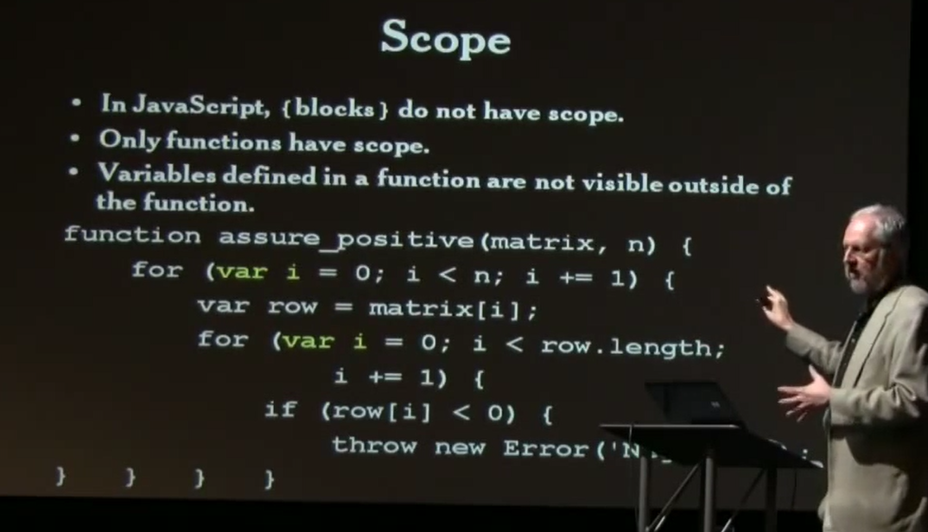
Variable Hoisting
Variables are hoisted to top of functions.
Variables are hoisted out of blocks to tops of enclosing function.
source: Crockford: http://www.youtube.com/watch?v=ya4UHuXNygM

Slide 52
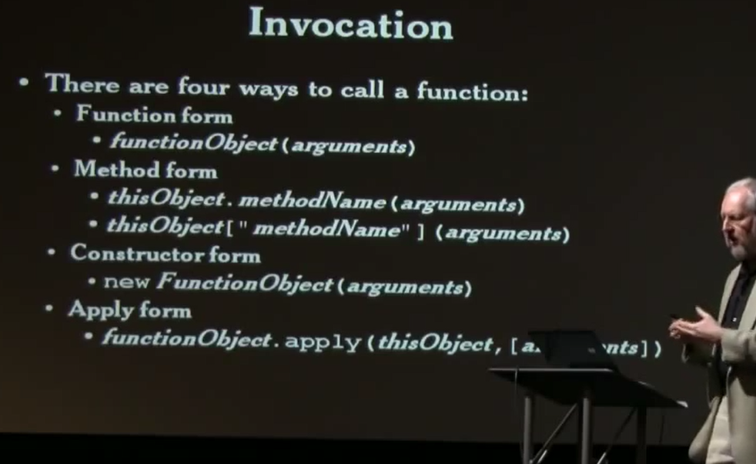
Function Invocation
source: Crockford: http://www.youtube.com/watch?v=ya4UHuXNygM

